Slide 1
Applied Data Science Machine Learning in Python
Dr. Omri Allouche
2017

Slide 2
Refresher
http://machinelearningmastery.com/tutorial-to-implement-k-nearest-neighbors-in-python-from-scratch/

Slide 3
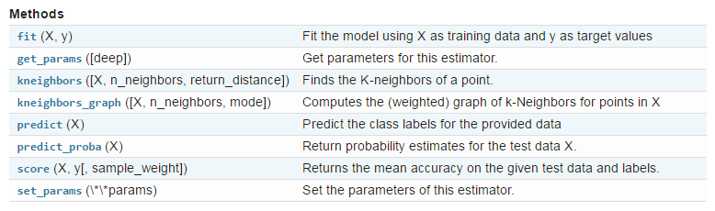
Methods

Slide 4
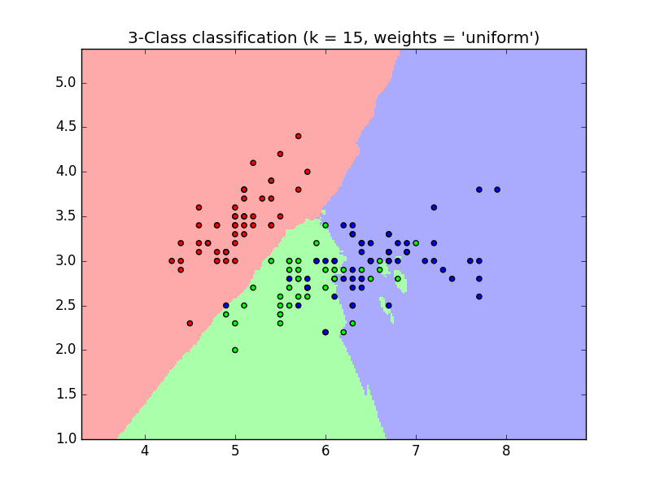

Parameters
http://scikit-learn.org/stable/modules/generated/sklearn.neighbors.KNeighborsClassifier.html

Slide 5
Distance Metrics
Manhattan distance
Euclidean
Jaccard
Minkowsky

Slide 6
When to use?
Scalability
Interpretability
Dimensionality
Sensitivity to outliers
Dependence on parameters

Slide 7
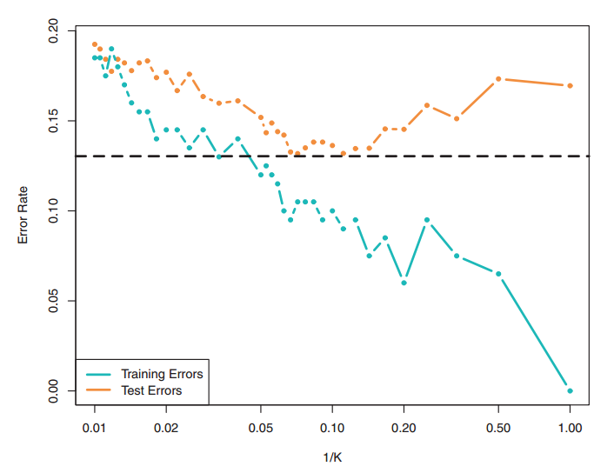
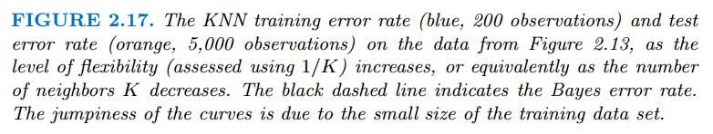
Training And Test Errors
This pattern is a common pattern for Machine Learning algorithms.
Can you explain the patterns?

Slide 8
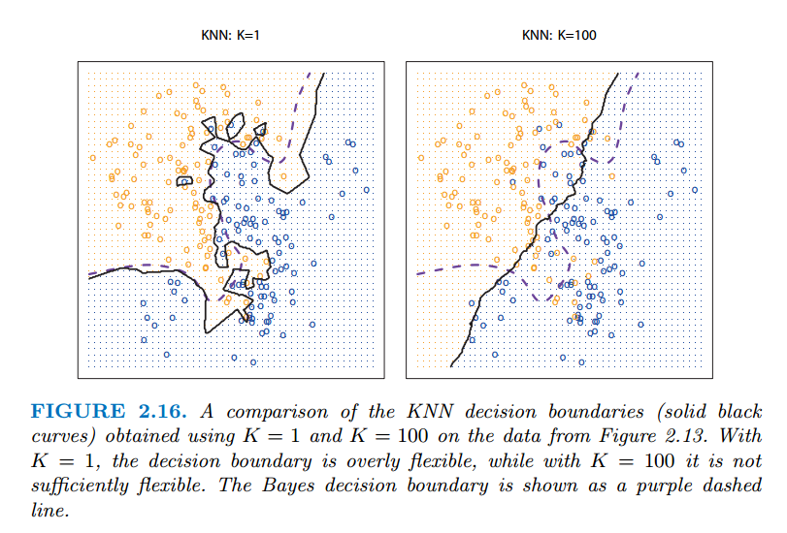
Effect of K
Rule of thumb – Use K = sqrt(#observations)

Slide 9
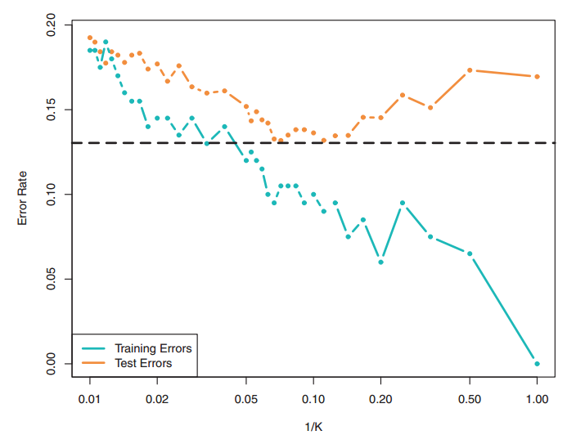
Effect of Model Flexibility (1/K)

Slide 10
Effect of Model Flexibility (1/K)

Slide 11
Exercises
On the Iris data:
Find the optimal number of neighbors for classification
Plot classification decision boundaries for k=5
Analyze whether the probability assigned is related to the actual accuracy

